Slide 1
Cloud Computing Overview

Slide 2
Agenda
What is Cloud Computing
Cloud Categorization
Cloud Implementation Architecture
Key Enabling Technologies
Sample Clouds

Slide 3
What is Cloud Computing
Cloud computing describes computation, software, data access, and storage services that do not require end-user knowledge of the physical location and configuration of the system that delivers the services
“By 2012, 80% of Fortune 1000 enterprises will use some Cloud Computing services” - Gartner

Slide 4
Cloud Computing Characteristics
Very Large Scale
Virtualization
High Reliability
Multiple Services
High scalability
On-Demand Service
Pay per use

Slide 5
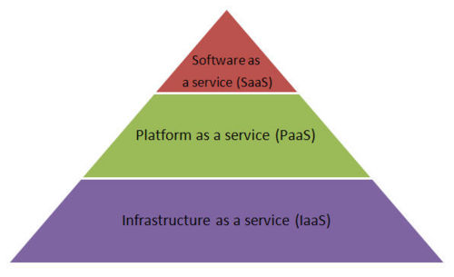
Cloud Categorization -- By Service Type
IaaS (Infrastructure as a Service)
Offering web-based access to storage and computing power. The consumer does not need to manage or control the underlying cloud infrastructure but has control over the operating systems, storage, and deployed applications.
Samples: Amazon EC2/S3
PaaS (Platform as a Service)
Giving developers the tools to build and host web applications
Samples: Google App Engine, Microsoft Windows Azure
SaaS (Software as a Service)
Access applications from various client devices through a thin client interface such as a web browser
Samples: Salesforce online CRM
More Specific
More Generic

Slide 6
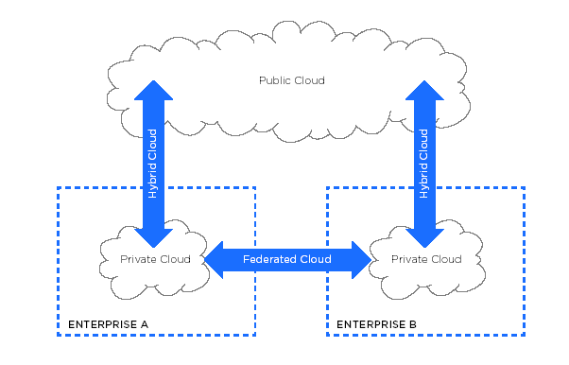
Cloud Categorization -- By Usage
Public Cloud
Private Cloud
Hybrid Cloud

Slide 7
Cloud Implementation Architecture
Service Interface
Service Register
Service Discovery
Service Access
Workflow
SOA Layer
Management Middleware
Security Mgmt
ID Mgmt
User Mgmt
User Environment Mgmt
Interactive Mgmt
Billing
Authentication
Authorization
Task Mgmt
IMG deploy & Mgmt
Task Dispatch
Task Execution
Life Cycle mgmt
Auditing
Resource Mgmt
General Protection
Load Balance
Error Detection
Disaster Recovery
Monitoring & Metrics
Resource Pool
Calculation Pool
Storage Pool
Network Pool
Data Pool
Software Pool
Physical Resource
Computer
Storage
Network
Database
Software

Slide 8
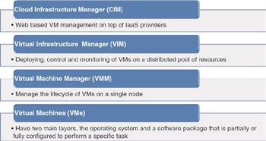
Key Enabling Technologies(1) Virtualization
Virtualization
partitioning or dividing the resources of a single server into multiple segregated VMs

Slide 9
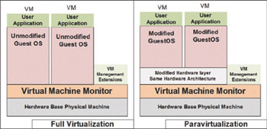
Virtual Machine Manager/Monitor
VMM | Type | Highlights | Guest performance | License
KVM | Full virtualization | Assigns every VM as a regular Linux process | Close to native | Open source
Xen | Paravirtualization | Supports VM migration on fly | Native | Open source
VMware | Full virtualization | Provides a mature product family to manage virtual infrastructure | Close to native | Commercial
Microsoft hyper-V | Full virtualization | Able to trap guest calls | Close to native | Commercial

Slide 10
Virtual Infrastructure Manager
System name | Brief description | VM hypervisor | Cloud type
Enomaly | A programmable virtual cloud infrastructure for small, medium, and large businesses. Their Elastic Computing Platform (ECP) helps users to design, deploy, and manage virtual applications in the cloud, and also significantly reduces administrative and systems workload. A browser-based dashboard enables IT personnel to simply and efficiently plan deployments, automate VM scaling and load-balancing, and analyze, configure, and optimize cloud capacity. | Xen, KVM | Private and public
Eucalyptus | "Elastic Utility Computing Architecture Linking Your Programs To Useful Systems"—is an open-source software infrastructure for implementing cloud computing on clusters. The current interface to Eucalyptus is compatible with Amazon's EC2, S3, and EBS interfaces, but the infrastructure is designed to support multiple client-side interfaces. | Xen, KVM, VMware | Private and public
Nimbus | Nimbus has been developed in part within the Globus Toolkit 4 framework and provides interfaces to VM management functions based on the WSRF set of protocols. There is also an alternative implementation implementing Amazon EC2 WSDL. | Xen | Private and public
Open Nebula | Orchestrates storage, network, and virtualization technologies to enable the dynamic placement of multitier services (groups of interconnected VMs) on distributed infrastructures, combining both data center resources and remote cloud resources, according to allocation policies. | Xen, KVM, VMWare | Private, hybrid, and public cloud

Slide 11
Cloud Infrastructure Manager
System name | Brief description | Pricing | Cloud provider
Rightscale | Rightscale is a cloud management environment, cloud-ready server template and best-practice deployment library, adaptable automation engine, and multi-cloud engine. | Starting at US$500, monthly fee | Amazon web services, GoGrid, FlexiScale
Elastra | Elastra's main features are: application infrastructure modeling, federated hybrid cloud management, lifecycle orchestration, and deployment management. | Pricing not published | AWS
Kaavo | IMOD is for Application-Centric Management of virtual resources in the clouds. It provides easy-to-use web interface for deploying, running, and managing complex multiserver n-tier applications in the cloud. | Pricing not published | EC2
CohesiveFT | PN-Cubed is a commercial solution that enables customer control in a cloud, across multiple clouds, and between private infrastructure and the clouds. | Starting with US$5,000 per year | EC2, Elastic hosts

Slide 12
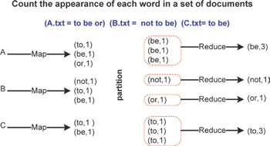
Key Enabling Technologies(2) Map Reduce

Slide 13
Key Enabling Technologies(3) Web Services
 | Age | Transport | Key Tech | Categories | Implementations
RPC | 1974 | TCP/IP | Stubs, IDL | Infrastructure, IaaS | Java RMI, XML RPC, .Net Remoting, RPyC, CORBA
SOA | 1998 | HTTP, FTP, SMTP | WSDL UDDI SOAP | Architecture level, PaaS | IBM Websphere, Microsoft .Net IIS, Weblogic
REST | 2000 | HTTP, FTP, SMTP | Web-oriented | Architecture level, DaaS | RIP, Rails, Restlet, Jboss RESTEasy, Apache CXF, Symfony
MASHUP | 2000 later | HTTP | Web-oriented (Web 2.0) | Application level, SaaS | Google Mashup editor, JackBe, Mozilla Ubiquity

Slide 14
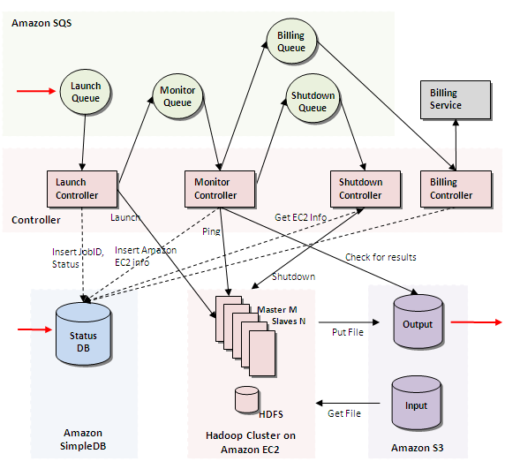
Sample Clouds -- Amazon EC2 (IaaS)

Slide 15
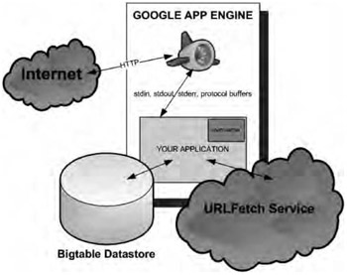
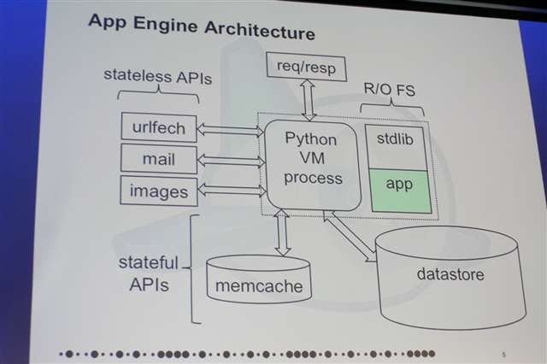
Sample Clouds -- Google App Engine (PaaS)

Slide 16
Thanks!

